Slide 1
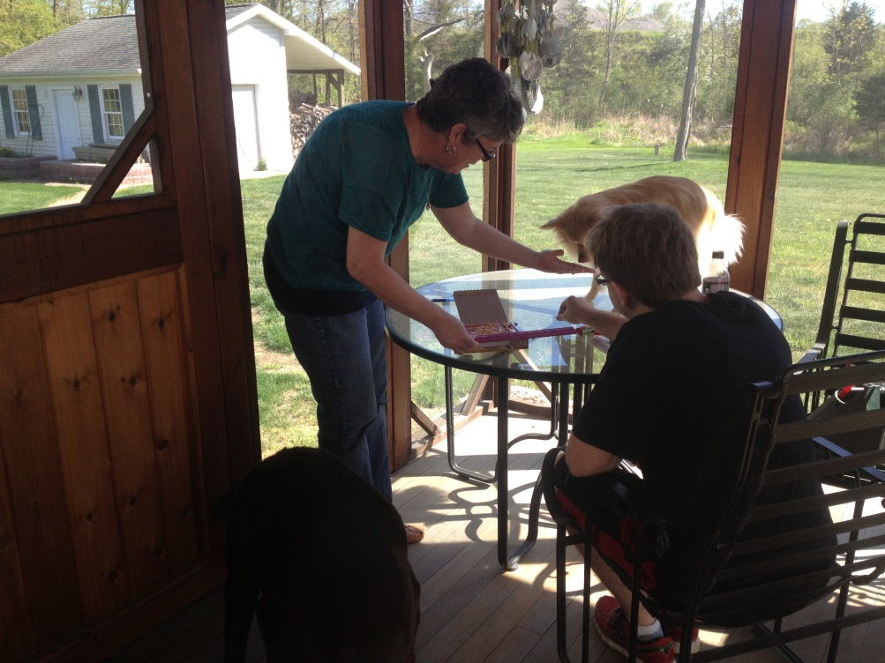
Discovering percent error
Casey Sutton
Goal:
Students will discover the meaning percent error through their understanding of volume.

Slide 2
objectives
Students will explore their understanding of volume.
Students will record and measure volume.
Students will build an understanding of percent error.

Slide 3
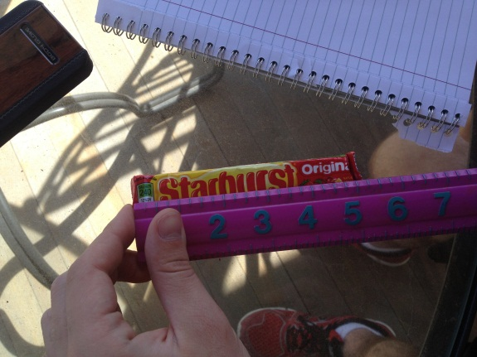
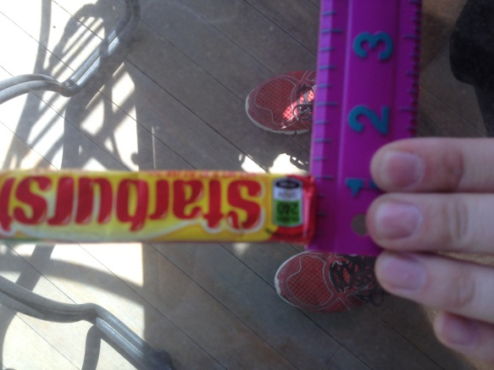
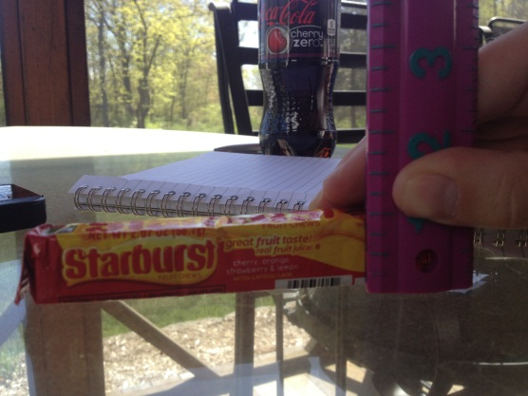
Discovering volume
Step 1: Measure and Record the dimensions of your Starburst package (in inches)
Starburst Package Dimensions
Length | 5 inches
Width | 0.75 inches
Height | 0.75 inches

Slide 4
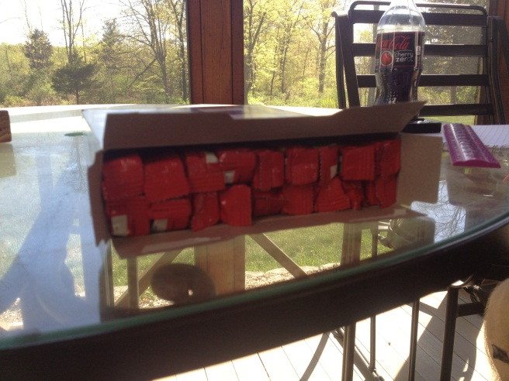
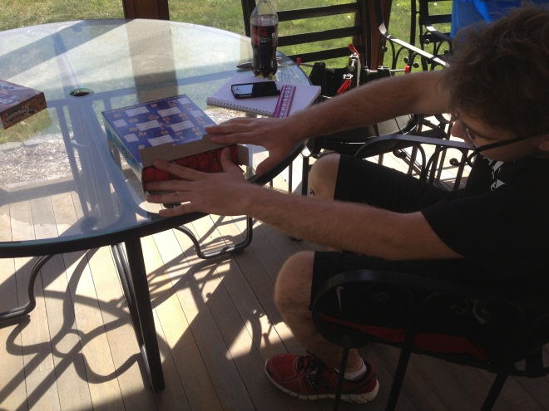
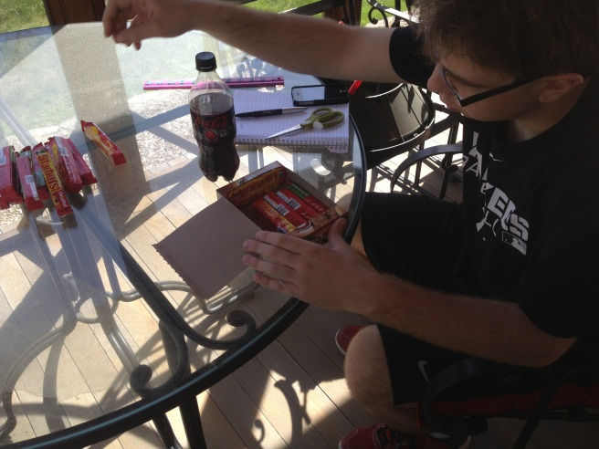
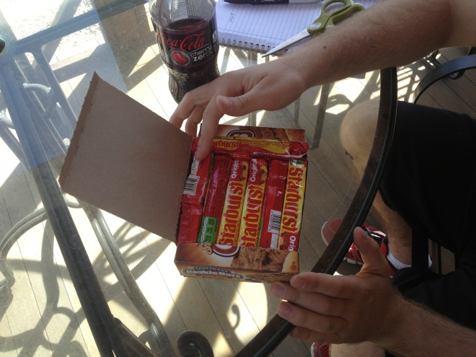
Discovering volume
Step 2: Find out how many Starbursts packages fill up the your box?
Box Type | Number of Starburst Packages
Cinnamon Toast Crunch (C.T.C) | 36 Packages
Fruit Bar Box | 32 Packages

Slide 5
Discovering Volume
Step 3: Determine the Volume of your box by multiplying the volume of ONE Starburst package with how many starburst packages fit in your box.
Type of Box | Calculations Volume X # of Packages | Final Answer
C.T.C | 2.8125 X 36 | 101.25
Fruit Bar Box | 2.8125 X 32 | 90

Slide 6
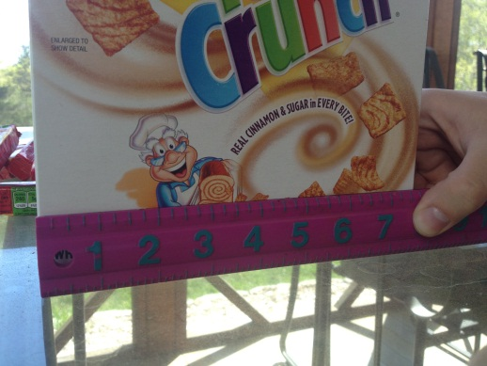
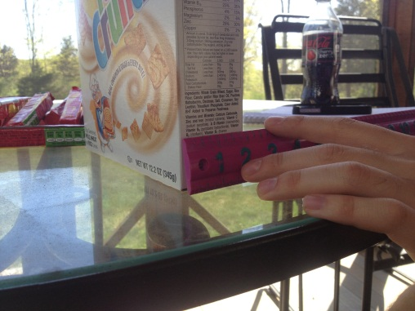
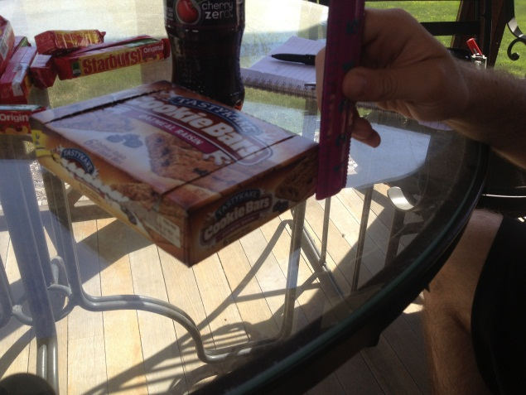
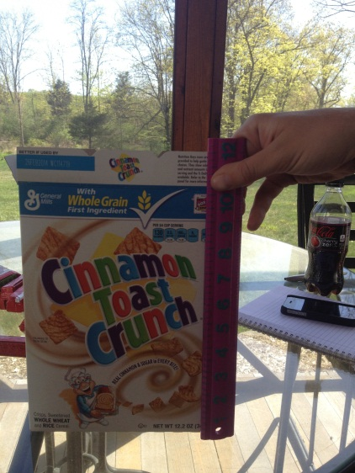
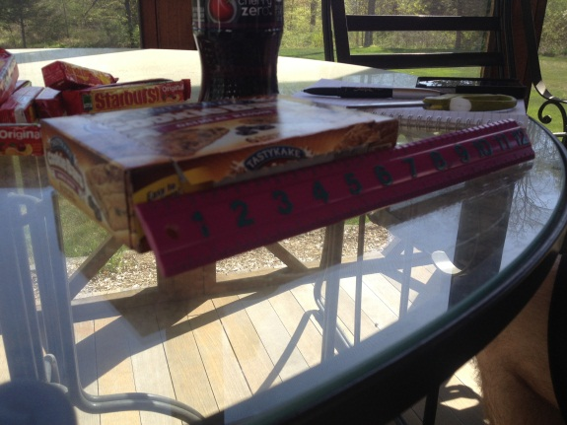
Discovering volume
Step 4: Measure the Length, Width and Height of your object (using a ruler)
Dimension | Cinnamon Toast Crunch | Fruit Box
Length | 7.5 inches | 7 inches
Width | 2 inches | 5 inches
Height | 10.75 inches | 1.75 inches

Slide 7
Discovering volume
Step 5: Calculate the actual Volume using the equation $V=L×W×H$
Type of Box | Calculations | Final Answer
C.T.C | $$V=7.5 in ×10.75 in ×2 in$$ | $$V=161.25 {in}^{3}$$
Fruit Bar Box | $$V=7in×5in×1.75in$$ | $$V=61.25 {in}^{3}$$

Slide 8
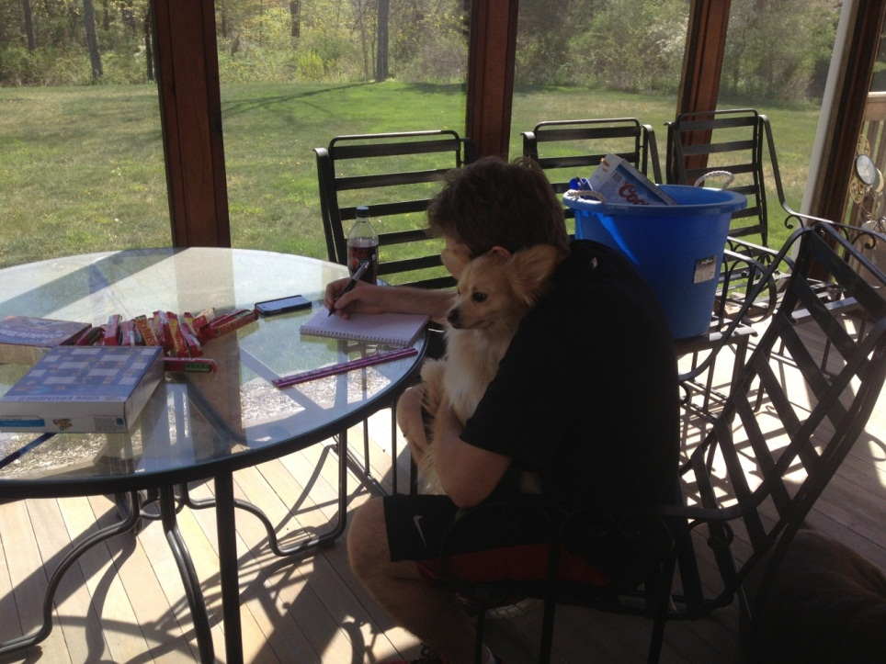
Discovering volume
Step 6: What do you notice about your answer in step 3 and step 5? What do you think this says about the volume of your box?
Type of Box | First Value(Step 3) | Second Value (Step 5)
C.T.C | $$101.25 in^{3}$$ | $$161.25in^{3}$$
Fruit Box | $$90 in^{3}$$ | $$61.25 in^{3}$$

Slide 9
Percent error
Percent error = x 100%
Cinnamon Toast Crunch Box
Experimental Value | True Value | Calculations | Percent Error
101.25 | 161.25 | $$\frac{161.25 −101.25}{161.25} ×100$$ | $$37.2\%$$
Fruit Bar Box
Experimental Value | True Value | Calculations | Percent Error
90 | 61.25 | $$\frac{90 −61.25}{61.25} ×100$$ | $$46.9\%$$

Slide 10
Resources
http://www.educationworld.com/a_tsl/archives/06-1/lesson015.shtml

